Slide 1
Lesson no 5
ELECTROMAGNETIC SPECTRUM

Slide 2
01. Introduction
02. EMS Management
03. EMS Operations
CONTENTS

Slide 3
01. Introduction

Slide 4
Spectrul electromagnetic – EMS (Electromagnetic Spectrum) este mediul în care EW este condus.
Orice lucru care utilizează energia EM are un potenţial important de EW.

Slide 7
02. EMS Management

Slide 8
The International Telecommunication Union (ITU) is the United Nations specialized agency for information and communication technologies – ICTs.
Founded in 1865 to facilitate international connectivity in communications networks, allocate global radio spectrum and satellite orbits, develop the technical standards that ensure networks and technologies seamlessly interconnect, and strive to improve access to ICTs to underserved communities worldwide.

Slide 9
The ITU Radiocommunication Sector (ITU-R) is one of the three sectors (divisions or units) of the International Telecommunication Union (ITU) and is responsible for radio communications.
Its role is to manage the international radio-frequency spectrum and satellite orbit resources and to develop standards for radiocommunication systems with the objective of ensuring the effective use of the spectrum.
ITU is required, according to its constitution, to allocate spectrum and register frequency allocation, orbital positions and other parameters of satellites, “in order to avoid harmful interference between radio stations of different countries”. The international spectrum management system is therefore based on regulatory procedures for frequency coordination, notification and registration.

Slide 10
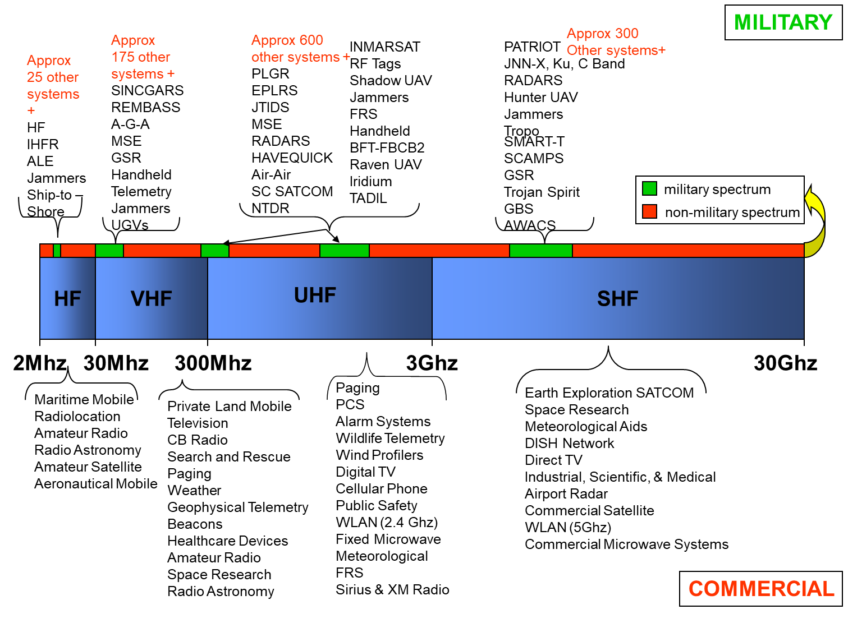

Slide 11
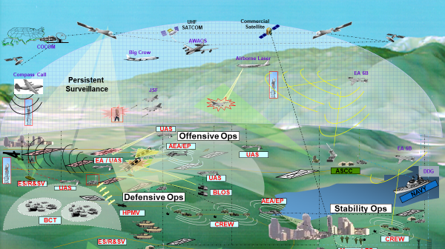

Slide 12
03. EMS Operations

Slide 13
Electromagnetic Spectrum Operations
EM Spectrum Operational Environment
EM Spectrum Operations
Host Nation
Coordination
Navigation
Sensor
Satellite
EW Ops
ES
EP
Spectrum
Management
EA
Comm
Networks
Frequency
Assignments
CREW
Radar
Munitions
UAS/
UGS
Policy
Air Defense
IRR
Notes:
Spectrum Management traditionally done by D9 spectrum managers with a focus on frequency assignments for Comm networks only. It was considered a part of the Network Management portion of NetOps.
Net Centric Warfare requires access to the Electromagnetic Spectrum Battlespace (EMSB).
Electromagnetic Spectrum Operations (EMSO) enables the warfighter’s use the EMSB.
All emitters to include satellite, navigation systems, sensors, radars, munitions, Air Defense/IRR, UAS/UGS, and EW systems are all users of the RF Spectrum. Their spectrum requirements require intensive management to ensure that they are de-conflicted prior to issuing a frequency assignment.
Each nation has sovereign rights to their spectrum. Host nation coordination takes place prior to deconflicting frequencies and making the frequency assignment.
Spectrum use is governed by DOD, National, and International policy.
The introduction of CREW systems has introduced another degree of complexity to Spectrum Operations. They are user owned and operated which presents a challenge as to how we employ them to protect our soldiers while not interfering with other Blue systems.
Coordination between the EWO and the G6/S6 must be constant and may require a dedicated Spectrum Operations NCO (25E) to perform this mission.
We must clearly define the EW and Spectrum Operations lanes to effectively use access to the spectrum as a combat multiplier.

Slide 14
Thanks

